Slide 1
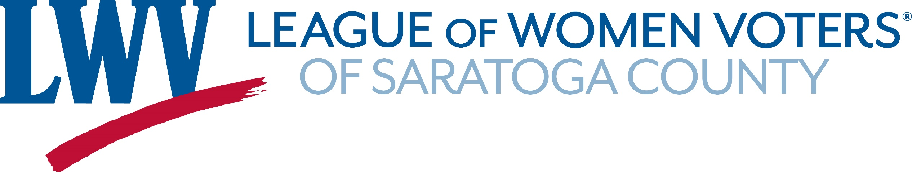
Local Governments
September, 2019
PO Box 1029, Saratoga Springs, NY 12866 www.lwvsaratoga.org email: president@lwvsaratoga.org

Slide 2
Local Governments
County Governments
Town, City and Village Governments
In Saratoga, Warren and Washington Counties

Slide 3
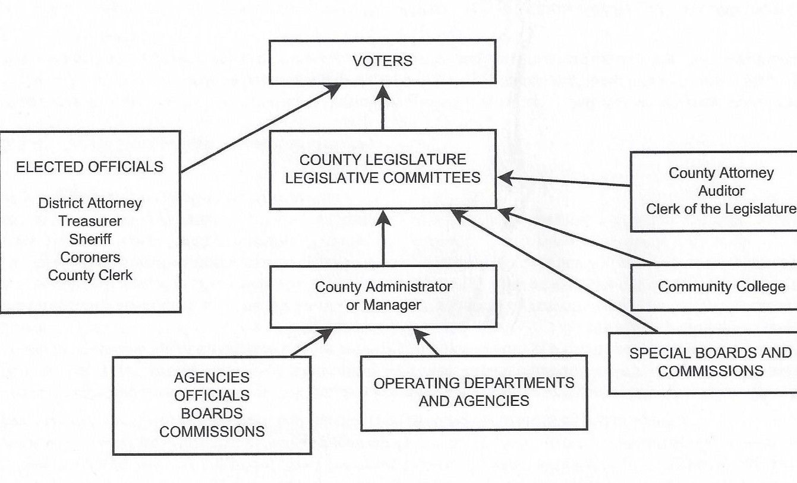
Note: Board of Supervisors is the County Legislature

Slide 4
Board of Supervisors Form of County Government
This traditional form of governing counties is where all NY State counties started.
Of NYS’ 62 counties only 17 retain this form while 40 have changed to elected legislatures, based on equal population districts. (And 5 counties form NYC).

Slide 5
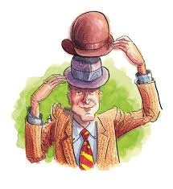
Two Hats
Supervisors who have joint responsibility for running their towns and serving on the County Board spend considerably more time on their towns than the county. They wear two hats.
Notes:
Saratoga Springs and Mechanicville have Supervisors who wear “one hat”
Clifton Park has one additional “one hat” Supervisor, along with a “two hat
Supervisors seem to have primary allegiance to their towns.
Current position is to add a 2nd Supervisor when the population reaches 25,000
Milton and Halfmoon expected to reach this mark in2020 or 2030 census, , not expected in the 2010 census

Slide 6

One Hat
Supervisors who have no town or city duties could spend more time on county governance but do not seem to: some because of County Structure and some because of partisan concerns. They wear only one hat.
Notes:
Saratoga Springs and Mechanicville have Supervisors who wear “one hat”
Clifton Park has one additional “one hat” Supervisor, along with a “two hat
Supervisors seem to have primary allegiance to their towns.
Current position is to add a 2nd Supervisor when the population reaches 25,000
Milton and Halfmoon expected to reach this mark in2020 or 2030 census, , not expected in the 2010 census

Slide 7
Town Supervisors
Elected by the voters in their Town
Chair their Town Board
Represent their Town on the Board of Supervisors

Slide 8
Board of Supervisors
Controls the Budget for all Departments
(whether head is elected or appointed)

Slide 9
The Chair of the BOS appoints:
The County Administrator
The Department Heads, except those elected by the public.
The chairs and members of all Board Committees
Notes:
Often the Chair of the BOS serves for only one year – and usually has served as Chair of the Law & Finance Committee the previous year.

Slide 10
Committees of the Board
Department heads provide input to the corresponding committee, suggesting resolutions to pass.
Notes:
The makeup of the BOS is overwhelmingly Republican and many decisions appear to have been made in the Republican Caucus prior to public discussion.

Slide 11
Committees of the Board
Much of the work of the Board of Supervisors is done by the committees.
Chairs and members are appointed by the Chair of the Board of Supervisors.
Chairmanship of committees usually changes yearly.
Notes:
The supervisors hold productive discussions at some of the committee meetings, others seem to have little discussion.
Agendas for the committee meetings are generally set by the committee chair, with input from staff from the agencies and departments which report to that committee.
There are occasional items introduced at committee meetings as “new business”
Chairmanship of committees often changes each year, limiting the expertise of the chairs and giving great weight to the input of department heads.

Slide 12
Supervisors have a weighted voting system.
Baker v. Carr
  US Supreme Court 1965
  One Person- One Vote
Notes:
Weighted voting has nothing to do with the body size of the county supervisors. But it has a lot to do with the “clout” each supervisor wields on the County Board. When the U.S. Supreme Court required state and local governing bodies to be equalized by population, it did not dictate the structure of that equalization. So Saratoga County kept the previous county supervisor system and assigned voting power equal to the population of the town represented by its supervisor. Numerically there are about 200,000 people and supervisor votes on Saratoga County Board; at the two extremes, the Town of Day has 856 votes and Clifton Park has 36,704 votes. They are called “weighted” votes because the voting supervisor carries the “weight” of the population in his/her municipality as opposed to representing a voting district of roughly equal populations as is the case in legislative systems. The “supervisor system” retains existing municipal boundaries and the integrity of the “one man-one vote” rule by weighting the votes of each county board supervisor.

Slide 13
Towns
are governed by a Town Board
Board consists of a Supervisor and 4 Board members
Voters elect a Highway supervisor
Are not permitted to provide fire or police protection

Slide 14
Services Towns Provide:
Roads and Bridges (on Town Roads)
Planning and zoning
Building Permits
Recreation & Open Space (sometimes)
Licenses & Death Certificates
Some Towns contract with the Sheriff’s Department for some police services.
Towns cannot provide certain services except in Special Districts
Notes:
Towns cannot provide police, fire or schools except in special districts.

Slide 15
Villages
By NYS Law they are run by a Mayor and 4 Council members.
They exist within a Town or Towns, and pay Town taxes as well as Village taxes.
They are permitted to have fire, police, water and sewer services (unlike Towns).
Notes:
Ballston Spa is located in both the Town of Milton and the Town of Ballston.
Schuylerville desn’t have police, Waterford does.

Slide 16
Saratoga County
19 Towns
2 Cities Mechanicville and Saratoga Springs
Villages
13 School Districts
Numerous Special Districts (Fire, Ambulance, Water, Sewer, Rec.)
County Seat is Ballston Spa
Notes:
Cities and towns are non- coterminous
Villages are located within parts of one or more Town.
Cities: Mechanicville and Saratoga Springs
Villages: Ballston Lake, Ballston Spa, Corinth, Galway, Schuylerville, South Glens Falls, Victory, Waterford
School Districts: Ballston Spa, Burnt Hills-Ballston Lake, Corinth, Edinburg, Hadley-Luzerne, Galway, Mechanicville, Stillwater, Waterford-Halfmoon, Saratoga Springs, Schuylerville, Shenendehowa, South Glens Falls

Slide 17
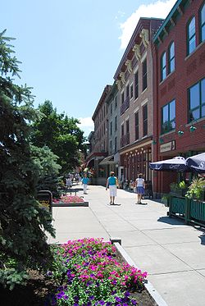
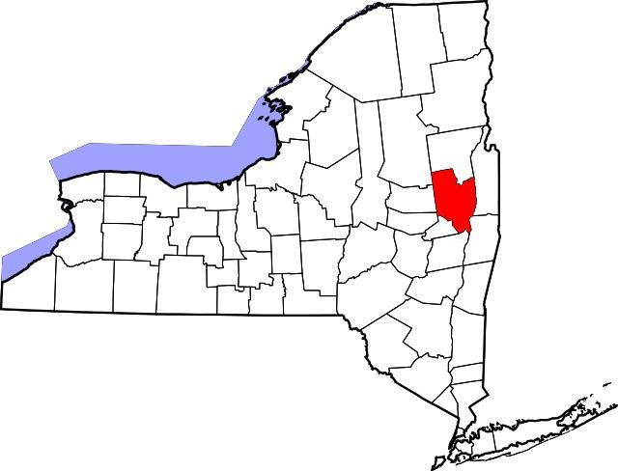
Saratoga County
Saratoga County is a county in the U.S. state of New York. As of the 2018 U.S. Census estimate, the county's population was 230,163, representing a 4.8% increase from the 2010 population of 219,607,representing one of the fastest growth rates in the northeastern United States and the fastest-growing county in Upstate New York.
Notes:
Cities and towns are non- coterminous
Villages are located within parts of one or more Town.
Cities: Mechanicville and Saratoga Springs
Villages: Ballston Lake, Ballston Spa, Corinth, Galway, Schuylerville, South Glens Falls, Victory, Waterford
School Districts: Ballston Spa, Burnt Hills-Ballston Lake, Corinth, Edinburg, Hadley-Luzerne, Galway, Mechanicville, Stillwater, Waterford-Halfmoon, Saratoga Springs, Schuylerville, Shenendehowa, South Glens Falls

Slide 18
List of Saratoga County Supervisors
Town – Weighted Vote- Incumbent
Ballston – 9,776– Timothy Szczepaniak
Charlton – 4,133- Alan Grattidge
Clifton Park – 18,352 - Jonathan Schopf *
Clifton Park – 18,352 - Philip Barrett
Corinth – 6,531 - Richard B. Lucia
Day – 856- Preston Allen
Edinburg – 1,214- Jean Raymond
Galway – 3,545 - Michael Smith
Greenfield – 7,775- Daniel Pemrick
Hadley – 2,048- Arthur M. Wright
Halfmoon – 21,535- Kevin Tollisen
Malta – 14,728- Darren O’Connor
Mechanicville –5,196- Thomas Richardson *
Milton – 18,575- Scott Ostrander
Moreau – 14,728- Theodore Kusnierz
Northumberland – 5,087- Willard Peck
Providence – 1,995- Sandra Winney
Saratoga – 5,674- Thomas N. Wood III
Saratoga Springs – 13,293- Tara Gaston *
Saratoga Springs – 13,293- Matthew Veitch *
Stillwater – 8,287- Edward D. Kinowski
Waterford – 8,423- John E. Lawler
Wilton – 16,173- Arthur J. Johnson
*These Supervisors have no administrative duties in their Town or City. All other Supervisors wear two hats: one as Supervisor of their Town and one as a member of the Board of Supervisors.

Slide 19
Saratoga County Departments
Departments with Directors who have been elected in a county-wide election:
County Clerk (runs Dept. of Motor Vehicles, too)
Coroners
County Treasurer
District Attorney
Sheriff’s Office
» Board of Elections
Commissioners – one Republican, one Democratic – are recommended by their County Party Chair and appointed by the Chair of the Board of Supervisors.
Notes:
The budgets for these and all other Departments are set by the Law & Finance Committee, the most powerful committee of the board.

Slide 20
Saratoga County Departments
Departments with heads appointed by Chair of the Board of Supervisors and Supervised by County Administrator:
Administrator’s Office, Clerk of BOS
County Attorney
Animal Shelter
County Auditor
County Historian
Employment & Training
Human Resources
Mental Health
Office for the Aging
Emergency Services
Planning
Probation
Public Defender
Public Health
Public Works
Purchasing
Real Property Tax Service Agency, Auctions
Saratoga County Cornell Cooperative Extension
Saratoga County Water Authority
Saratoga County Sewer Authority
Social Services
Soil & Water Conservation District
Veterans
Youth Bureau

Slide 21
Cities in Saratoga County:
Mechanicville & Saratoga Springs
Both retain a Commission Form of Government with 5 Commissioners
Commissioner of Public Safety – Supervises Police, Fire and Ambulance, Code Enforcement
Commissioner of Finance- develops Budget & pays bills
Commissioner of Accounts – responsible for assessments and tax billing, recording births & deaths.
Commissioner of Public Works – responsible for streets, city buildings, water and sewer infrastructure.
Mayor – titular head of the city, responsible for land use planning, zoning, building permits.

Slide 22
Cities in Saratoga County:
Mechanicville & Saratoga Springs (cont’d)
Elect Supervisors to represent the City on the Board of Supervisors.
Mechanicville gets one Supervisor with 5,196 votes.
Saratoga gets two Supervisors with 13,293 votes each.

Slide 23
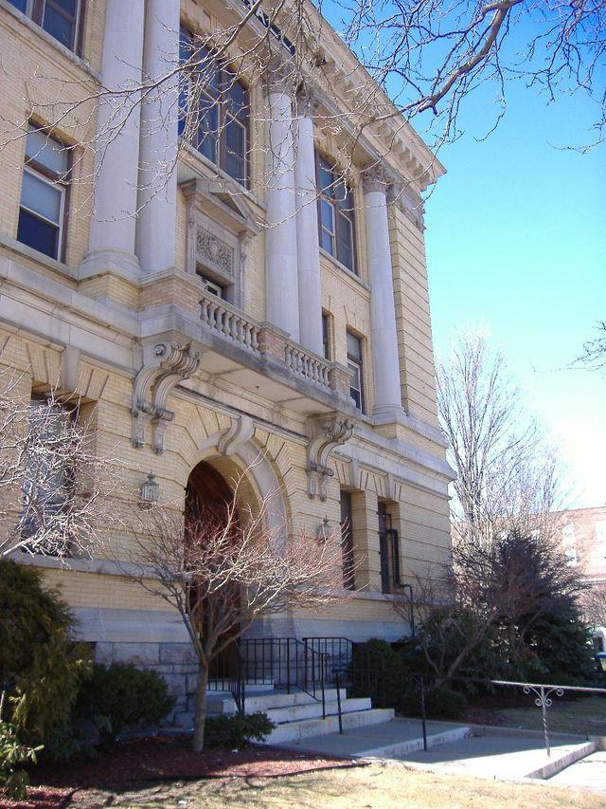
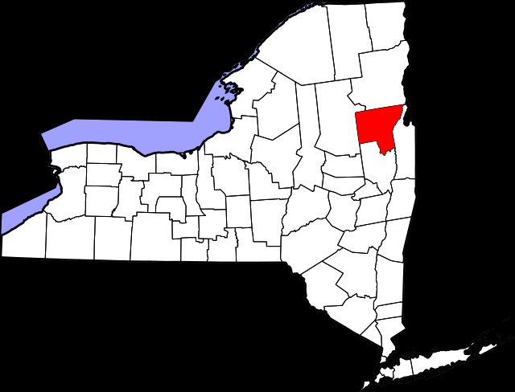
Warren County
Warren County is a county in the state of New York. As of the 2010 census the population was 65707.
Notes:
Cities and towns are non- coterminous
Villages are located within parts of one or more Town.
Cities
Villages
School Districts

Slide 24
Warren County
11 Towns
1 City Glens Falls
1 Village
9 School Districts
Numerous Special Districts (Fire, Ambulance, Water, Sewer, Rec.)
County Seat is Queensbury
Notes:
Bolton School District. Bolton Landing. ...
Glens Falls City School District. Glens Falls.
Glens Falls Common School District. Glens Falls. ...
Hadley-Luzerne School District. ...
Johnsburg School District. ...
Lake George School District. ...
North Warren School District. ...
Queensbury School District.

Slide 25
MEMBERS OF THE BOARD OF SUPERVISORS
Bolton Supervisor
Chester Supervisor
City of Glens Falls
Ward 1 – County Supervisor
Ward 3 – County Supervisor
Ward 3 – County Supervisor
Ward 4 – County Supervisor
Hague Supervisor
Horicon Supervisor
Johnsbury Supervisor
Lake George Supervisor
Lake Lucerne Supervisor
Queensbury Town/County Supervisor
4 County only Supervisors
Stony Creek Supervisor
Thurman Supervisor
Warrensburg Supervisor
Town – Weighted Vote- Incumbent
Ballston – 9,776– Timothy Szczepaniak
Charlton – 4,133- Alan Grattidge
Clifton Park – 18,352 - Jonathan Schopf *
Clifton Park – 18,352 - Philip Barrett
Corinth – 6,531 - Richard B. Lucia
Day – 856- Preston Allen
Edinburg – 1,214- Jean Raymond
Galway – 3,545 - Michael Smith
Greenfield – 7,775- Daniel Pemrick
Hadley – 2,048- Arthur M. Wright
Halfmoon – 21,535- Kevin Tollisen
Malta – 14,728- Darren O’Connor
Mechanicville –5,196- Thomas Richardson *
Milton – 18,575- Scott Ostrander
Moreau – 14,728- Theodore Kusnierz
Northumberland – 5,087- Willard Peck
Providence – 1,995- Sandra Winney
Saratoga – 5,674- Thomas N. Wood III
Saratoga Springs – 13,293- Tara Gaston *
Saratoga Springs – 13,293- Matthew Veitch *
Stillwater – 8,287- Edward D. Kinowski
Waterford – 8,423- John E. Lawler
Wilton – 16,173- Arthur J. Johnson
*These Supervisors have no administrative duties in their Town or City. All other Supervisors wear two hats: one as Supervisor of their Town and one as a member of the Board of Supervisors.

Slide 26
Warren County Departments
Departments with Heads Elected by the Voters
COUNTY CLERK
CORONERS
COUNTY TREASURER
DISTRICT ATTORNEY
SHERIFF
JUDGES
BOARD OF ELECTIONS: Commissioners – one Republican, one Democratic – are recommended by their County Party Chair and appointed by Chair of Board of Supervisors

Slide 27
Warren County Departments
Departments with heads appointed by Chair of the Board of Supervisors
Assigned Council
Auditor
Building Code Enforcement
Civil
Service
County Administrator
Dept of Public Works
  Airport
Emergency Services
Economic Development
Health Services
Human Resources
Information Technology
Office for Aging
Office of Community Services
Planning and Development
Probation
Purchasing
Real Property Tax Services
Countryside Adult Home
Self Insurance
Social Services
Soil and Water
Tourism
Traffic Safety
Veterans
Weights and Measures
Youth Board

Slide 28
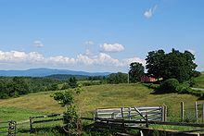
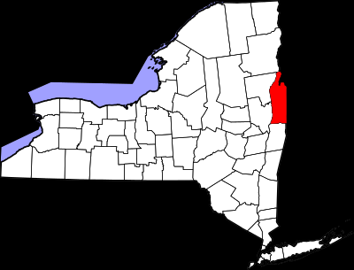
Washington County
Washington County is a county in the state of New York. As of the 2010 census the population was 63216.

Slide 29
Washington County
17 Towns
0 Cities
Villages
11 School Districts
Numerous Special Districts (Fire, Ambulance, Water, Sewer, Rec.)
County Seat is Fort Edward
Notes:
Argyle School District. Argyle. ...
Cambridge School District. Cambridge. ...
Fort Ann School District. Fort Ann. ...
Fort Edward School District. Fort Edward. ...
Granville School District. Granville. ...
Greenwich School District. Greenwich. ...
Hartford School District. ...
Hudson Falls School District.

Slide 30
Washington County Board of Supervisors
Town supervisors are elected biannually in town elections.
The Board Chair appoints the County Administrator,
The chairs and members of the standing committees.
All Department heads report to the appropriate committees for their department.

Slide 31
List of Washington County Supervisors
Argyle – Robert A. Henke – 275
Cambridge – Catherine Fedler – 148
Dresden – Paul D. Ferguson – 48
Easton – Daniel B. Shaw – 172
Fort Ann – Richard E. Moore – 273
Fort Edward – Terry L. Middleton – 448
Granville – Matthew Hicks – 474
Greenwich – Sarah Idleman – 376
Greenwich – Sarah Idleman – 376
Hampton – David K. O’Brien – 69
Hartford – Dana E. Haff – 166
Hebron – Brian R. Campbell – 137
Kingsbury – Dana Hogan – 780
Putnam – John R. LaPointe – 45
Salem – Evera Sue Clary -199
White Creek – Robert E. Shay – 244
Whitehall – John - 294
*The Board of Supervisors has both legislative and executive powers.
** Weighted voting is based on town population.

Slide 32
Washington County Committees
Finance | Government Operations | Health & Human Services
Public Safety | Personnel | Public Works
Board of Supervisors | Benefit resources | Committees
Local Laws | Resolutions | Tax Rates
Weighted Vote | Standard Work Day & Reporting | Agriculture, Tourism, Planning, Development
Audit | Community College
» Board of Elections
Commissioners – one Republican, one Democratic – are recommended by their County Party Chair and appointed by the Chair of the Board of Supervisors.

Slide 33
Washington County Departments
Departments with Heads Elected by the Voters
COUNTY CLERK
CORONERS
COUNTY TREASURER
DISTRICT ATTORNEY
SHERIFF
JUDGES
BOARD OF ELECTIONS: Commissioners – one Republican, one Democratic – are recommended by their County Party Chair and appointed by the chair of the Board of Supervisors.

Slide 34
Washington County Departments
Departments with heads appointed by Chair of the Board of Supervisors
Administration
Alternative Sentencing
Assigned Counsel Office
Building and Grounds
County Attorney
Code Enforcement
Economic Development
Fire Co-ordinator
Historian
Information Technology
Mental Health/Community Services
Motor Vehicles
Office of the Aging
Parks and Recreation
Personnel
Probation
Public Health & Nursing
Purchasing
Public Works
Public Defender
Planning
Purchasing
Real Property Tax Service
Sewer
Social Services
Veterans Services
Weights & Measures
WIC
Workers’; Comp

Slide 35
Resources
https://www.dos.ny.gov/lg/publications/Local_Government_Handbook.pdf
https://my.lwv.org/new-york-state
www.lwvny.org
https://my.lwv.org/new-york-state/civics-education
https://www.saratogacountyny.gov/
https://www.washingtoncountyny.gov/
https://www.warrencountyny.gov/

