Slide 1
Election & Registration Info February, 2024 PO Box 1029, Saratoga Springs, NY 12866 www.lwvsaratoga.org email: president@lwvsaratoga.org

Slide 2
Recent Laws Regarding
Elections

Slide 3
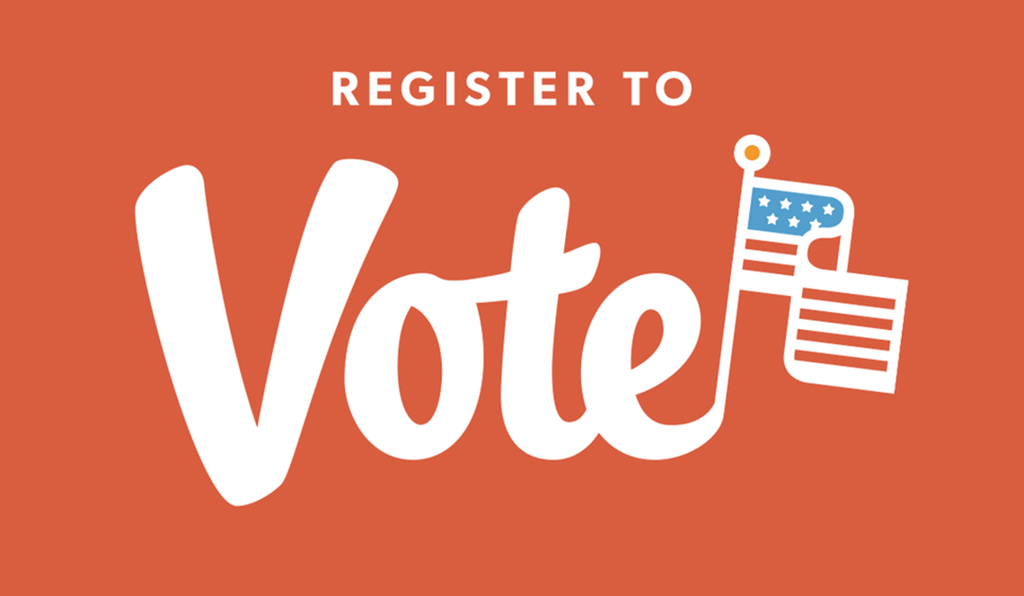
Pre- Registration of 16 and 17 year olds
Effective Jan 1, 2020
16 and 17 year olds may register to vote.
They will be able to vote in the election following their 18th birthday.

Slide 4
State-wide Voter Registration Transfer
Effective immediately
For moves within the state, your registration will follow you to your new location
Complete an affidavit ballot at your new poll site if you don’t show up on the poll books or e-poll books.

Slide 5
Early Voting
County must have one early voting site for every 50,000 voters
Must begin 10 days before the election
Must include one weekend
Must include some evening hours.
Became Effective November 5, 2019

Slide 6
Early Voting is available for all Elections, including the Presidential Primary https://elections.ny.gov/ for all election info
Notes:
No early voting on the day before Election Day
On election day you must go to your assigned polling place.

Slide 7
Presidential Primary & Election Dates in 2024
Last Day to change your Party Registration: Feb 14
Early Voting Dates: March 23 through March 30, hours vary
Last day to register for the Primary Election: March 23 (Cannot be used to change your party if currently registered)
Last day to apply in person for an absentee ballot: April 1
Last day to return an absentee ballot in person (or to postmark it): April 2
Presidential Primary: Tuesday, April 2
Polls are open 6am-9pm
Board of Elections Building: 1st Floor, 50 W. High St., Ballston Spa will be one of the early voting sites – Others to be announced.
Notes:
Voters may vote at any of these sites

Slide 8
Generic Election Calendar e
Last Day to change your Party Registration: Feb 14
Presidential Primary: First Tuesday in April (every 4 years)
Primary for state and local offices, and for US Congress and Senate: Last Tuesday in June
Election Day: First Tuesday of November
Early Voting: Begins 11 days before the election and ends on the 2nd day before the election. Includes weekends and some evening hours
Notes:
Voters may vote at any of these sites

Slide 9
New ! beginning in 2024 Early Voting by Mail Ballot e
Get Your Mail in Ballot:
https://elections.ny.gov/request-ballot
This early voting method is being challenged in the courts. Read about it here:
https://news.bloomberglaw.com/litigation/ny-mail-voting-law-will-be-in-effect-for-santos-special-election
Notes:
Voters may vote at any of these sites

Slide 10
New ! beginning in 2024 Most Local Elections are being moved to even years e
The change does not apply to city or village elections, and races for county clerk, sheriff, district attorneys, local judges and others protected in the state Constitution to be held in odd-numbered years.
This will likely be challenged in the courts. Read about it here:
https://spectrumlocalnews.com/nys/central-ny/news/2023/12/22/hochul-signs-bill-moving-many-local-elections-to-even-numbered-years
Notes:
Voters may vote at any of these sites

Slide 11
Primary Consolidation
Combines State and Congressional Primaries on the same day
Became effective June 25, 2019
Occurs on the 4th Tuesday in June
Presidential Primary still occurs in April

Slide 12
Electronic Poll Books
Instead of relying on paper-based voter rolls, counties will now be able to use electronic poll books on Election Day.
Electronic poll books have already proven to save voters time at poll sites, increase the accuracy of voter rolls, and save election administrators money over the years.
They will also be critical for implementing early voting in November.
Notes:
The state has allocated $14.7 million in appropriations for electronic poll books.

Slide 13
Online Voter Registration
Started in 2023
New York voters are able to register to vote online through the State Board of Elections website.
Notes:
Currently, New York voters are only able to register or update their voter registration through an online DMV portal if they have a license.

Slide 14
NYS Constitutional Amendment Process
Must be passed in two consecutive legislative sessions
Each legislative session is 2 years in length and starts on January 1 of an odd numbered year.
Following passage in 2 legislative sessions the proposed Constitutional Amendment must be passed by the voters in a general election.

Slide 15
Resources
www.lwvny.org
https://elections.ny.gov/
https://www.saratogacountyny.gov/departments/board-of-elections/

